Slide 1
AWS Integration & Messaging
SQS and SNS
Notes:
https://courses.cs.washington.edu/courses/cse403/13au/lectures/git.ppt.pdf
http://enos.itcollege.ee/~jpoial/allalaadimised/git/getting-started-with-git.pdf

Slide 2
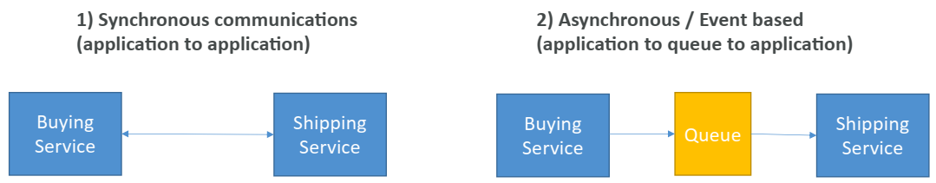
Introduction
When we start deploying multiple applications, they will inevitably need to communicate with one another
There are two patterns of application communication

Slide 3
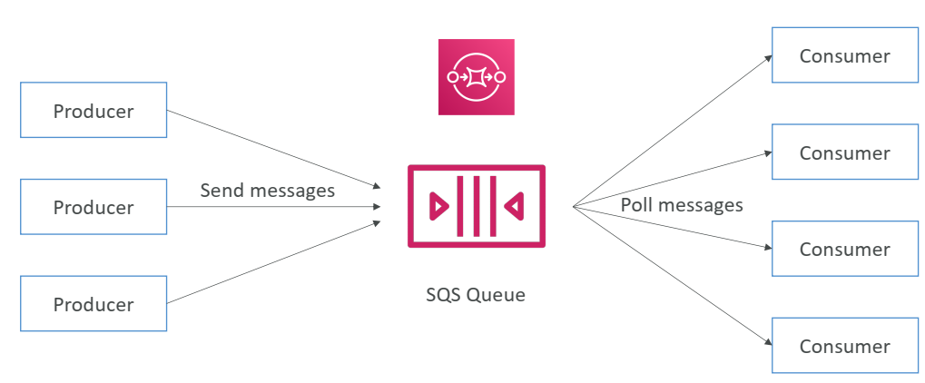
Amazon SQS - What’s a queue?

Slide 4
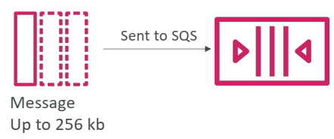
SQS – Producing Messages

Slide 5
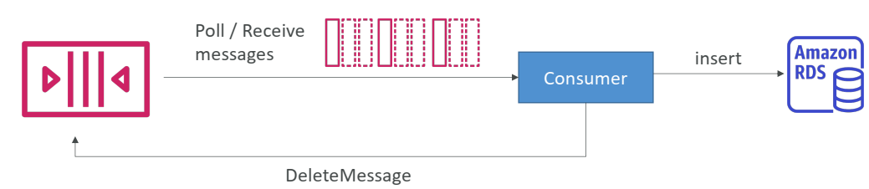
SQS – Consuming Messages

Slide 6
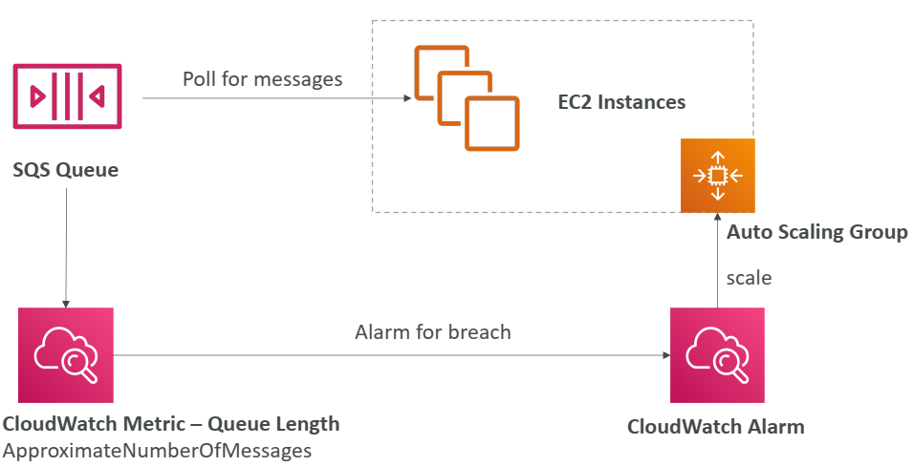
SQS with Auto Scaling Group (ASG)

Slide 7
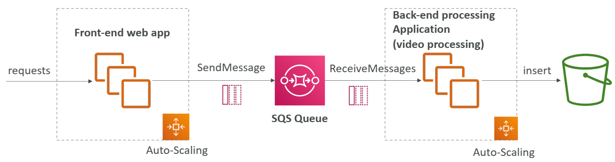
SQS to decouple between application tiers

Slide 8
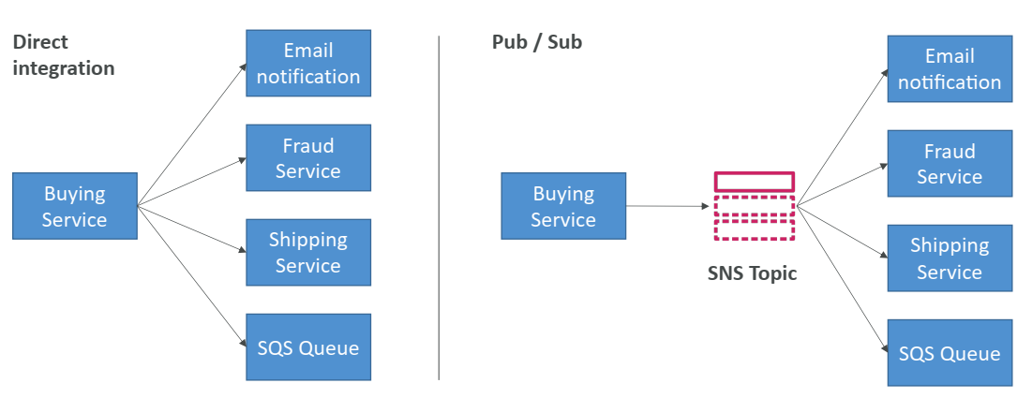
Amazon SNS
What if you want to send one message to many receivers?

Slide 9
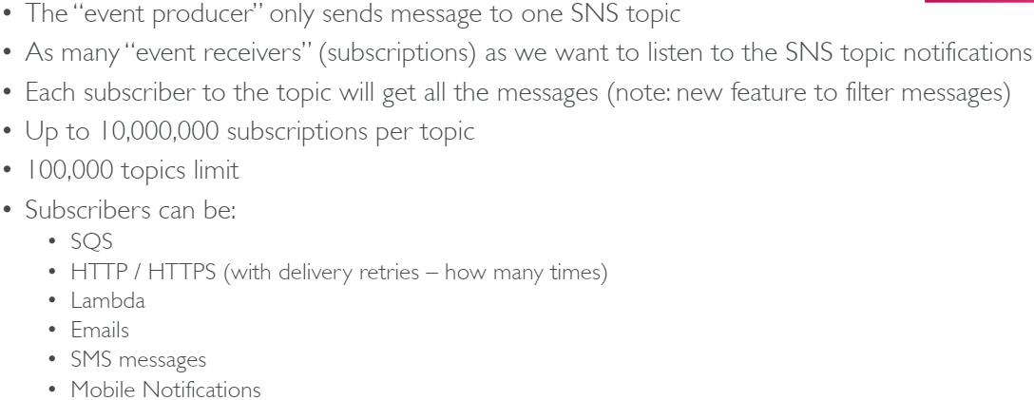
Amazon SNS

Slide 10
Thanks

